Slide 1
Devising a Solar Powered Standalone Vehicle using GSM Communication Network
SHALINI-
RANJITH –
KIRAN-

Slide 2
CONTENTS
Introduction
Basic block diagram of project
Circuit diagram and Explanation
Components used
Software used
Advantages and Disadvantages
Applications
Conclusion
References

Slide 3
PROJECT IDEA
Solar Power
Interface
Cell phone as a Transmitter
Cell phone as a Receiver
SPYROBO

Slide 4
INTRODUCTION
Conventionally, wireless controlled robots user circuits, which have a drawback of limited working range, limited frequency range and limited control. Use of mobile phones for robotic control can overcome these limitations. It provides the advantages of robust control, working range as large as the coverage area of the service provider, no interference with other controllers and up to twelve controls.
Although, the apperance and capabilities of robot vary vastly, all robots share the feature of a mechanical, movables structure under some form of control.

Slide 5
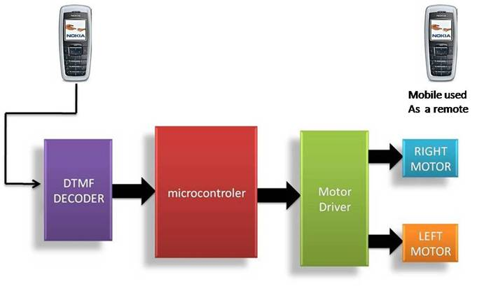
BLOCK DIAGRAM
Solar Power

Slide 6
WORKING
To control the robot by a mobile phone (as transmitter) that makes call to the mobile phone (as receiver) attached to the robot.
In the course of the call, if any button is pressed control corresponding to the button pressed is heard at the other end of the call. This tone is called dual tone multi frequency tome (DTMF) robot receives this DTMF tone with the help of phone stacked in the robot.
The received tone is processed by the microcontroller with the help of DTMF decoder MT8870 the decoder decodes the DTMF tone in to its equivalent binary digit and this binary number is send to the microcontroller,

Slide 7
WORKING
The microcontroller is preprogrammed to take a decision for any give input and outputs its decision to motor drivers in order to drive the motors for forward or backward motion or a turn.
The mobile that makes a call to the mobile phone stacked in the robot acts as a remote. So this simple robotic project does not require the construction of receiver and transmitter units
The signal generated by the DTMF encoder is the direct al-gebric submission, in real time of the amplitudes of two sine (cosine) waves of different frequencies, i.e., pressing 5 will send a tone made by adding 1336 Hz and 770 Hz to the other end of the mobile.

Slide 8
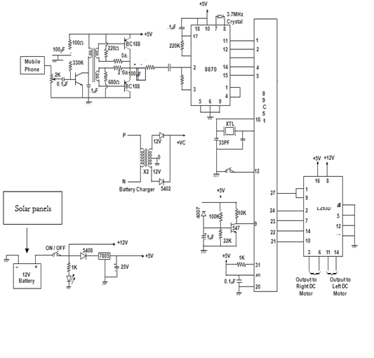
CIRCUIT DIAGRAM

Slide 9
COMPONENT USED
* Semiconductors: IC1 - MT8870 DTMF decoder IC2 – 8051 microcontroller IC3 - L293D motor driver * Diode - 1N4007 rectifier diode * Resistors - R1, R2 - 100-kilo-ohm R3 - 330-kilo-ohm R4-R8 - 10-kilo-ohm | * Capacitors: C1 - 0.47μF ceramic disk C2, C3, C5, C6 - 22pF ceramic disk C4 - 0.1μF ceramic disk * Miscellaneous: XTAL1 - 3.57MHz crystal XTAL2 - 12MHz crystal * S1 - Push-to-on switch * M1, M2 – 12V, 100-rpm geared DC motor * Battary - 12V

Slide 10
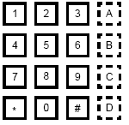
DTMF SIGNALS AND DTMF DECODING CIRCUIT
DTMF “Dual Tone Multiple-Frequency”.
Used in a telecommuncating signaling
The 16-keys touch tone pad.
DTMF assigns a unique ‘sound’ to each key.
Keys are arranged in a matrix of 4 columns and 4 rows.

Slide 11
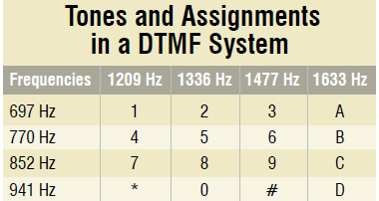

Slide 12
DTMF DECODER IC

Slide 13
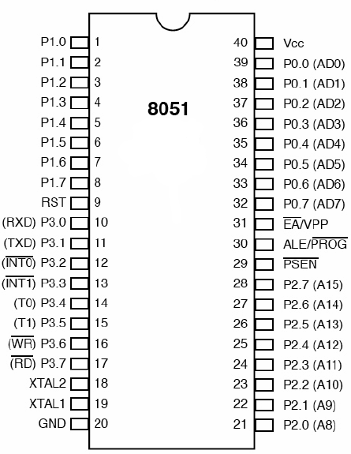
Micro Controller

Slide 14
DC MOTOR CONTROLLER L293D
Microcontroller output is not sufficient to drive DC motors, so L293D is used.
L293D comes in 16-pin DIP. It can provide current upto 600mA at voltages from 4.5V to 36V.
It can be used to drive inductive loads such as relays, solenoids etc
In the project it is used for simultaneous bi-directional control of two DC motors.

Slide 15
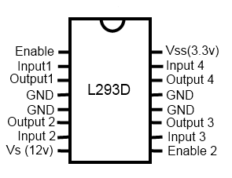
H-Bridge IC

Slide 16
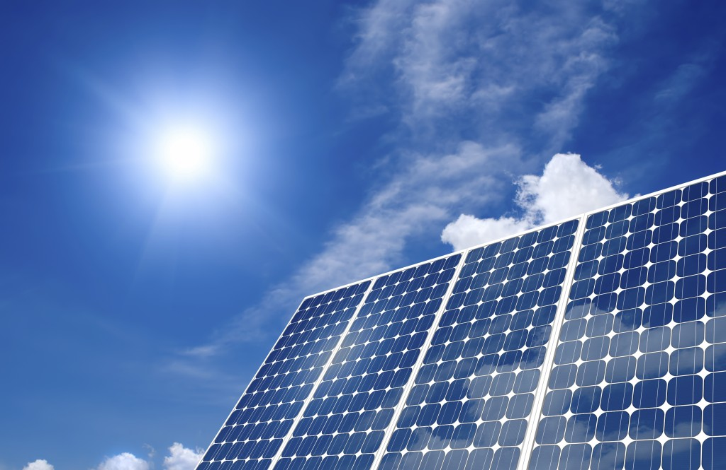
Solar Panel

Slide 17


SOFTWARE USED
1.EAGLE: This is software use to design PCB layout it is very easy to use have various component to work with.
2.KEIL :
To burn microprocessor Keil software is used.
3.The software is written in ‘C’ language .

Slide 18
ADVANTAGES
Wireless control
Surveillance System
Free external energy source
Takes in use of the mobile technology which is almost available everywhere
This wireless device has no boundation of range and can be controlled as far as network of cell phone

Slide 19
DISADVANTAGES
Cell phone bill
Mobile batteries drain out early so charging problem.
Cost of project if Cell phone cost included.
Not flexible with all cell phones as only a particular , cell phone whose earpiece is attached can only be used

Slide 20
APPLICATIONS
Military and Law Enforcement
Soviet Red Army used remotely controlled Tibetans during 1930s in the Winter War and early stage of World War II. There were also remotely controlled cutters and experimental remotely controlled planes in the Red Army.
Search and Rescue
UAVs will likely play an increased role in search and rescue in the United States. This was demonstrated by the successful use of UAVs during the 2008 hurricanes that struck Louisiana and Texas.

Slide 21
APPLICATIONS
Scientific
Remote control vehicles have various scientific uses including hazardous environments, working in the Deep Ocean, and space exploration. The majority of the probes to the other planets in our solar system have been remote control vehicles, although some of the more recent ones were partially autonomous.
Recreation and Hobby
Small scale remote control vehicles have long been popular among hobbyists. These remote controlled vehicles span a wide range in terms of price and sophistication. There are many types of radio controlled vehicles. These include on-road cars, off-road trucks, boats, airplanes, and even helicopters.

Slide 22
Conclusion
Thus, we believe that our project will be beneficial for various purposes & hence our efforts will be fruitful.

Slide 23
Thank You ☺

Slide 24
QUERIES???

